Slide 1
Work Progress
By: Abdur Rehman

Slide 2
Model: "sequential_1"
_________________________________________________________________
Layer (type) Output Shape Param #
=================================================================
flatten_1 (Flatten) (None, 54) 0
dense_17 (Dense) (None, 48) 2640
dense_18 (Dense) (None, 96) 4704
dense_19 (Dense) (None, 224) 21728
dense_20 (Dense) (None, 192) 43200
dense_21 (Dense) (None, 104) 20072
dense_22 (Dense) (None, 48) 5040
dense_23 (Dense) (None, 4) 196
=================================================================
Total params: 97,580
Trainable params: 97,580
Non-trainable params: 0
_________________________________________________________________

Slide 3
The issue in the previous model training was it had too many parameters mainly because of not properly addressing the number of neurons and hidden layers.
The solution:
Previously the neurons used to change with each hidden layers. Therefor, the new neural network makes it constant for each hidden layers.
The other technique considered was to implement Regularizers
Regularizers allow you to apply penalties on layer parameters or layer activity during optimization.
activity_regularizer: Regularizer to apply a penalty on the layer's output

Slide 4
Search space summary
Default search space size: 6
input_delay_size (Int)
{'default': None, 'conditions': [], 'min_value': 2, 'max_value': 20, 'step': 1, 'sampling': None}
activation_ (Choice)
{'default': 'relu', 'conditions': [], 'values': ['relu', 'tanh', 'sigmoid'], 'ordered': False}
units_nodes_ (Int)
{'default': None, 'conditions': [], 'min_value': 10, 'max_value': 90, 'step': 10, 'sampling': None}
hidden_layers (Int)
{'default': None, 'conditions': [], 'min_value': 2, 'max_value': 10, 'step': 1, 'sampling': None}
learning_rate (Choice)
{'default': 0.1, 'conditions': [], 'values': [0.1, 0.01], 'ordered': True}
shuffle (Boolean)
{'default': False, 'conditions': []}

Slide 5
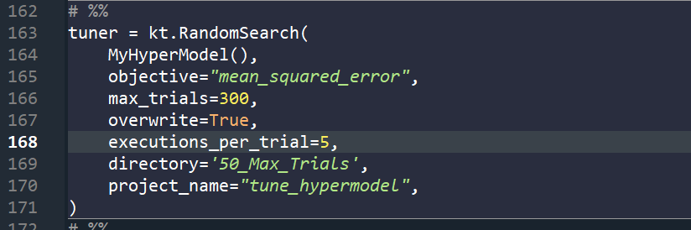

To find the best Hyperparameters, the search space had to be increased to number suitable to the amount of hyperparameters tuned.
The number suggested was in between 200 to 400
Also, the tolerance of the error being constant was changed to 10 steps

Slide 6
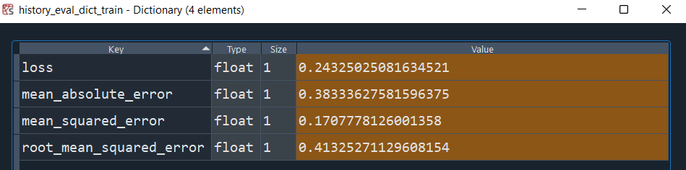

Best Hyperparameters Achieved
{'input_delay_size': 3, 'activation_': 'sigmoid', 'units_nodes_': 90, 'hidden_layers': 3, 'learning_rate': 0.01, 'shuffle': True}

Slide 7
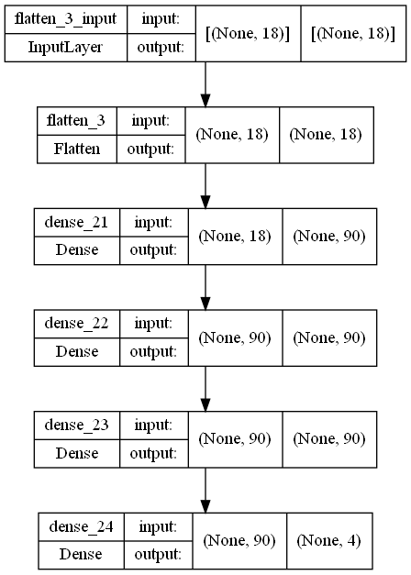

Slide 8
Model: "sequential_3"
_________________________________________________________________
Layer (type) Output Shape Param #
=================================================================
flatten_3 (Flatten) (None, 18) 0
dense_21 (Dense) (None, 90) 1710
dense_22 (Dense) (None, 90) 8190
dense_23 (Dense) (None, 90) 8190
dense_24 (Dense) (None, 4) 364
=================================================================
Total params: 18,454
Trainable params: 18,454
Non-trainable params: 0
_________________________________________________________________

Slide 9
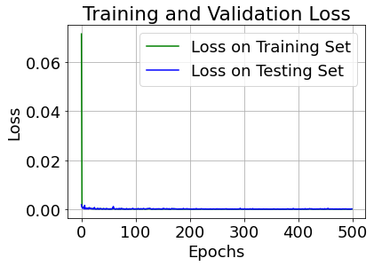
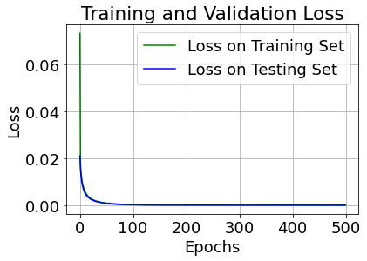

Slide 10
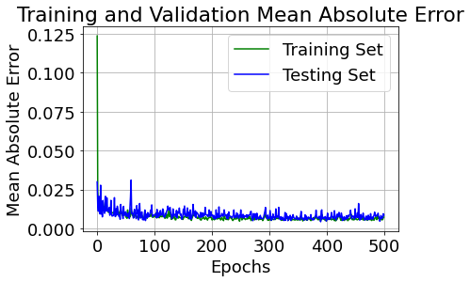
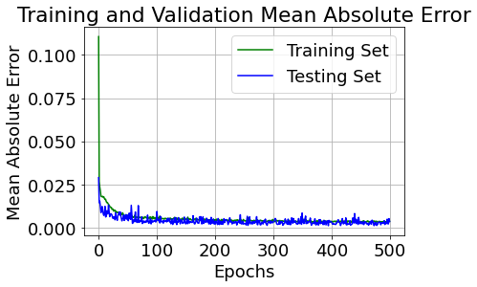

Slide 11
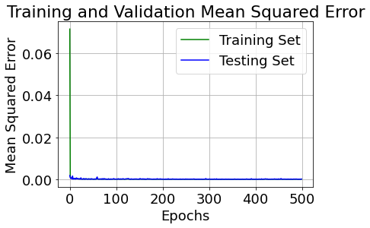
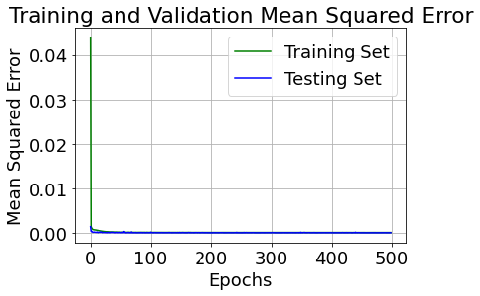

Slide 12
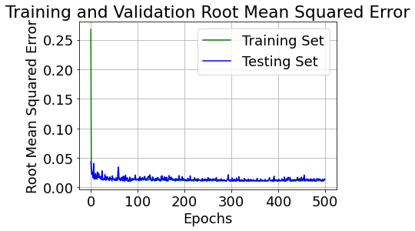
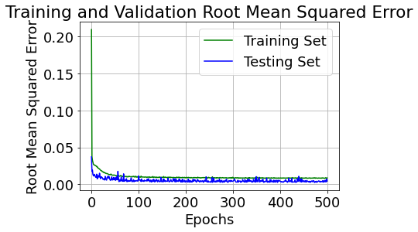

Slide 13
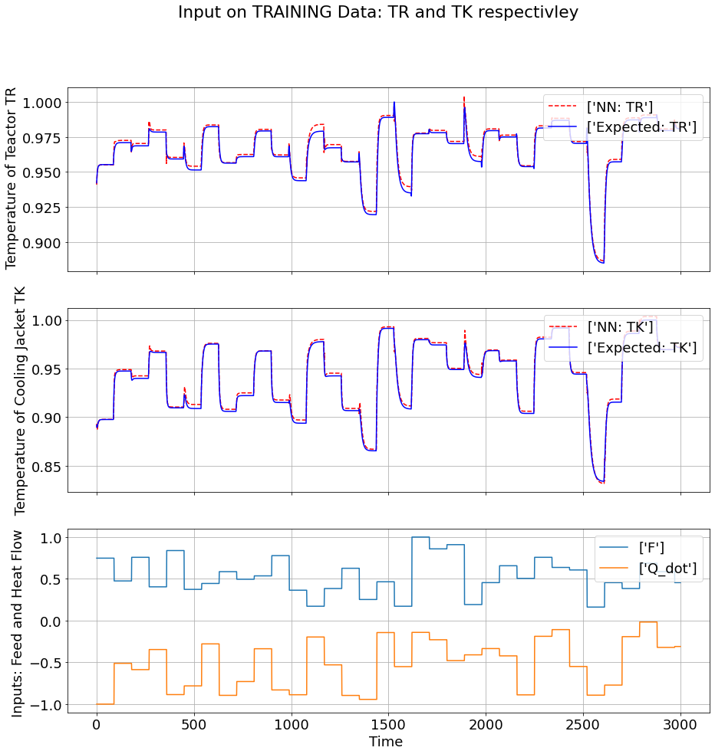

Slide 14
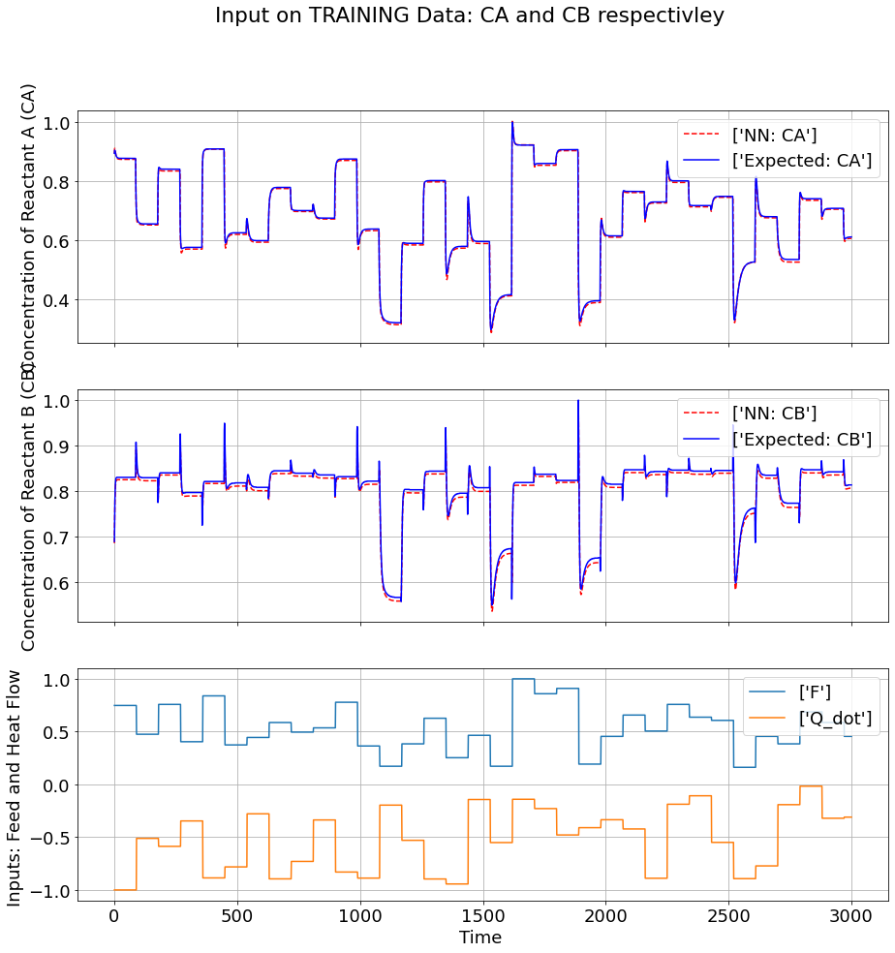

Slide 15
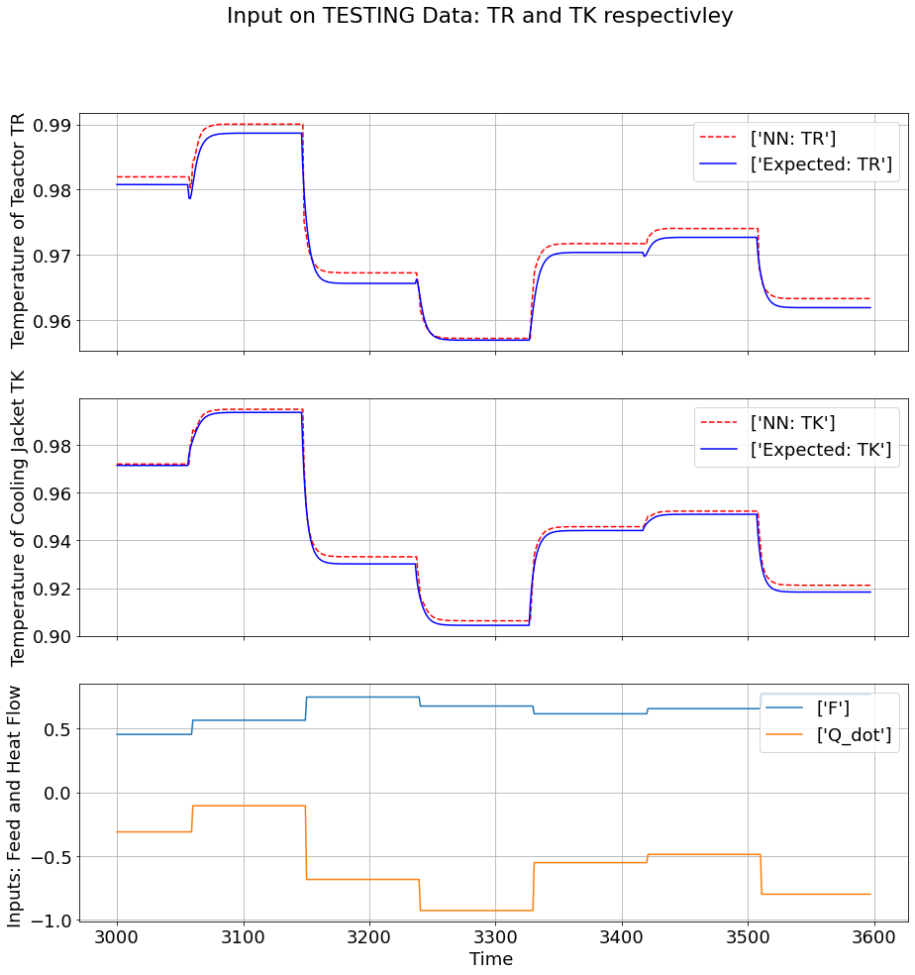

Slide 16
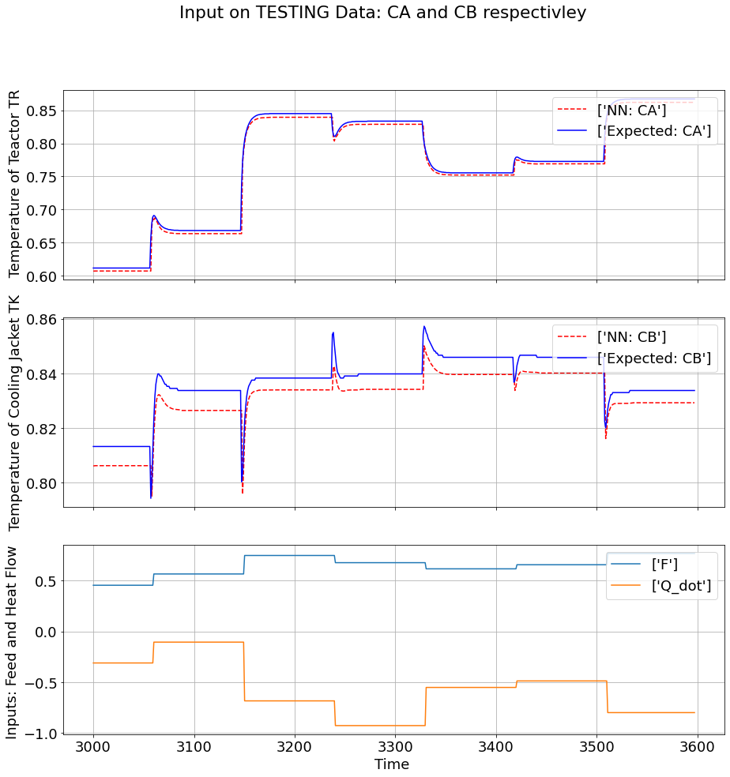

Slide 17
Closed Loop Simulation Results

Slide 18
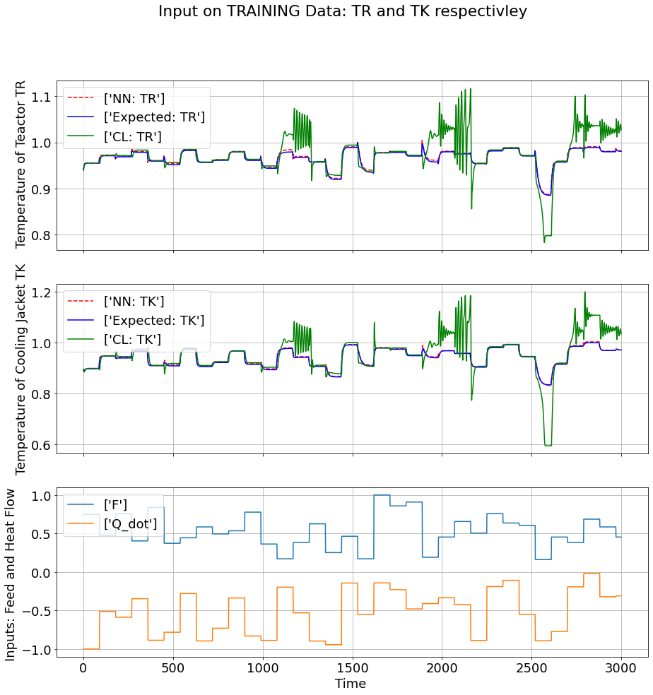

Slide 19
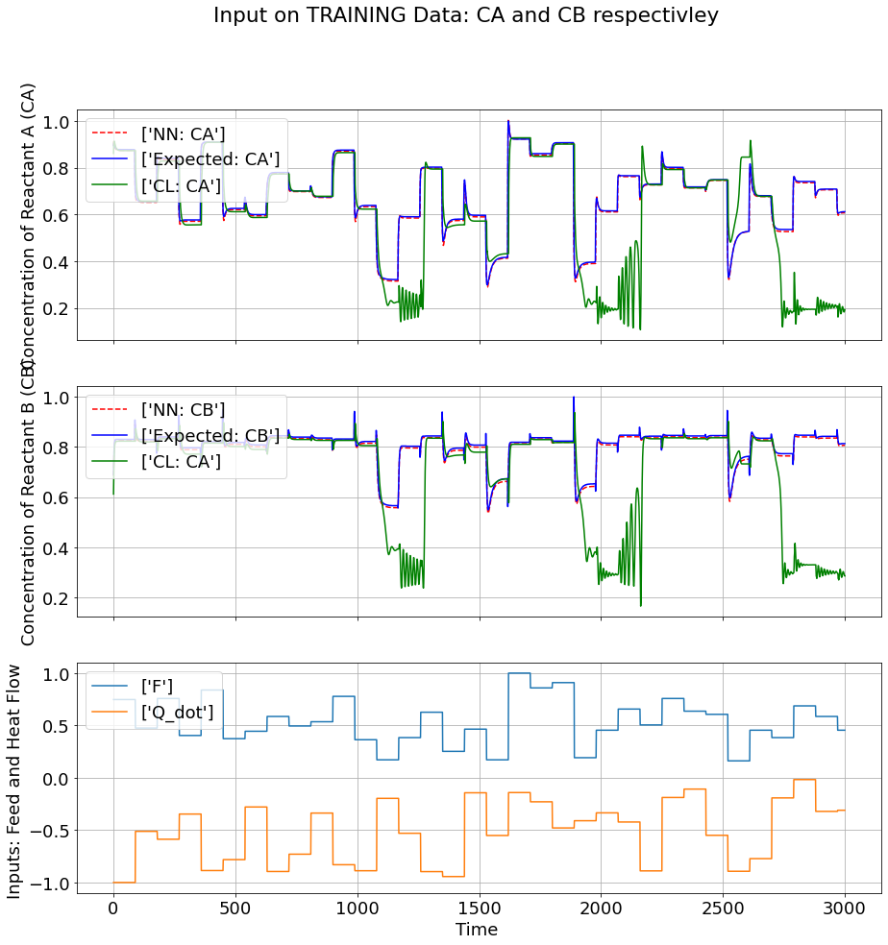

Slide 20
Physics Guided Neural Network

Slide 21
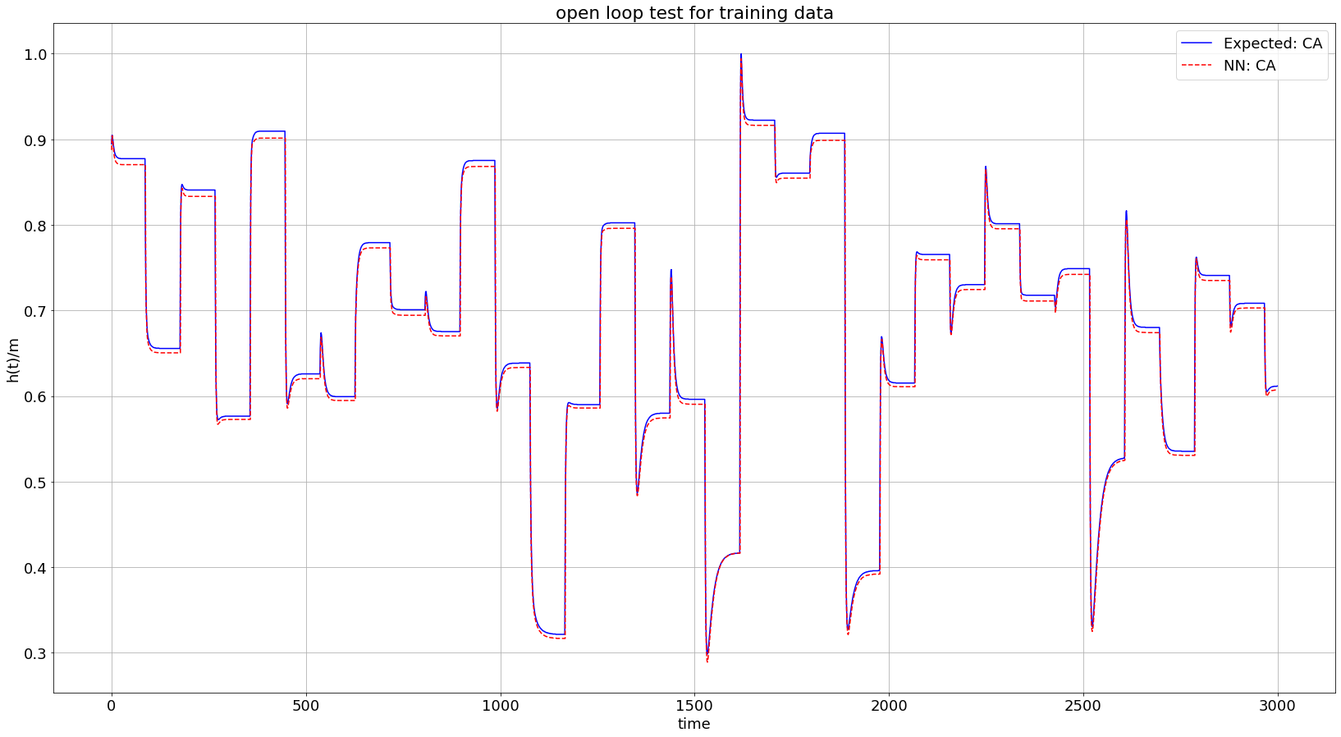

Slide 22
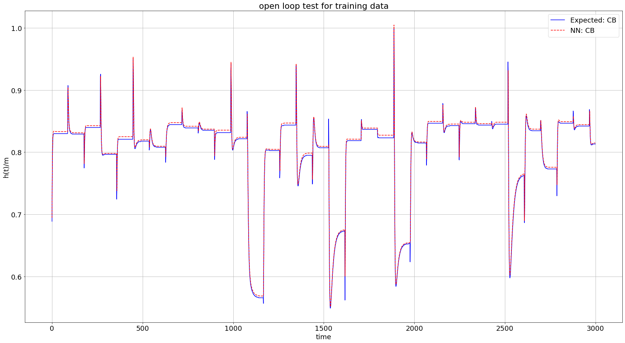

Slide 23
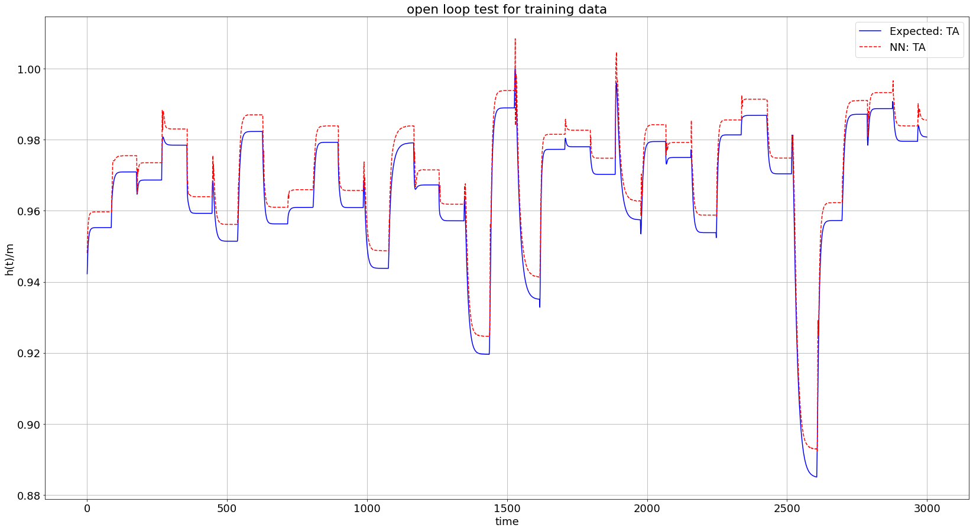

Slide 24
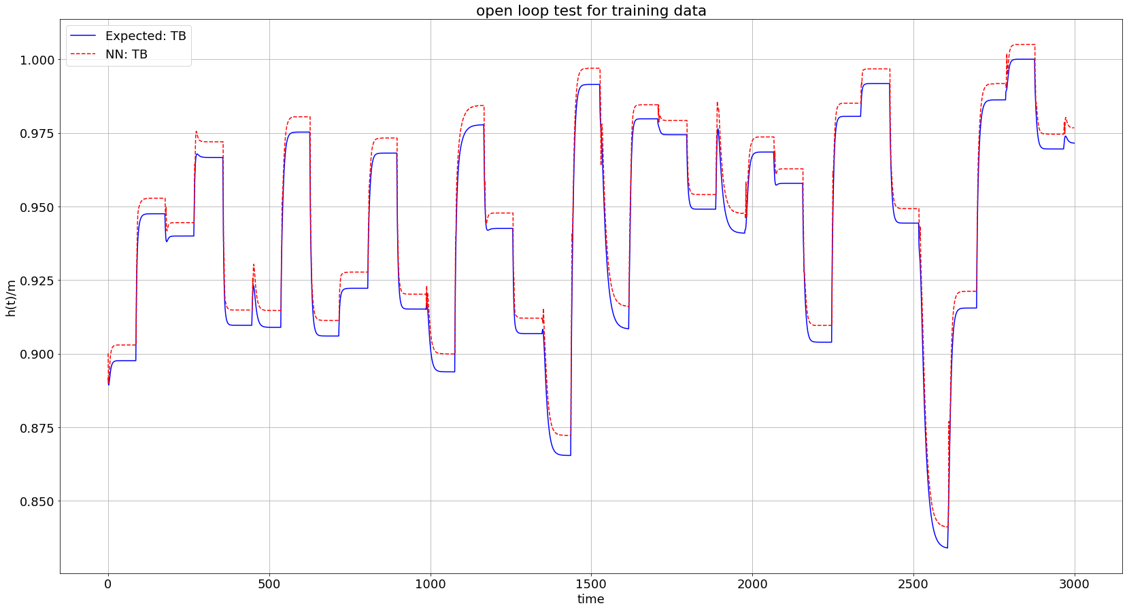

Slide 25
